Slide 1
HOSPITAL RESOURCE MANAGEMENT
presnted by
T.Navadeep-CDS/2025/1852 | B.Venkateswara Reddy-CDS/2025/1826

Slide 2

PROJECT OVERVIEW
A menu-driven C application designed to manage hospital resources and simulate patient transfers between facilities. The system supports comprehensive CRUD operations—adding, updating, deleting, and searching hospital records—with emphasis on efficient data handling and real-world hospital coordination.

Slide 3

PROJECT OBJECTIVES
Implement CRUD operations using C programming
Practice dynamic memory allocation with malloc() and free()
Use structured data types (struct) effectively
Build modular functions for maintainability and code reusability. Simulate hospital resource tracking and patient transfer basics to reflect real-world healthcare coordination scenarios.

Slide 4
KEY FEATURES
ADD & SEARCH
UPDATE
DISPLAY
Add new hospital records dynamically with automatic memory allocation. Search hospitals instantly by unique ID for quick access.
Update hospital details including name and available beds. Delete records safely with proper pointer adjustment and memory cleanup.
Display complete hospital list with real-time data. Track bed availability and resource status across all registered hospitals.
Our system leverages an efficient linked list data structure for flexible hospital record management, enabling dynamic operations with safe memory handling through proper malloc() and free() implementations.

Slide 5
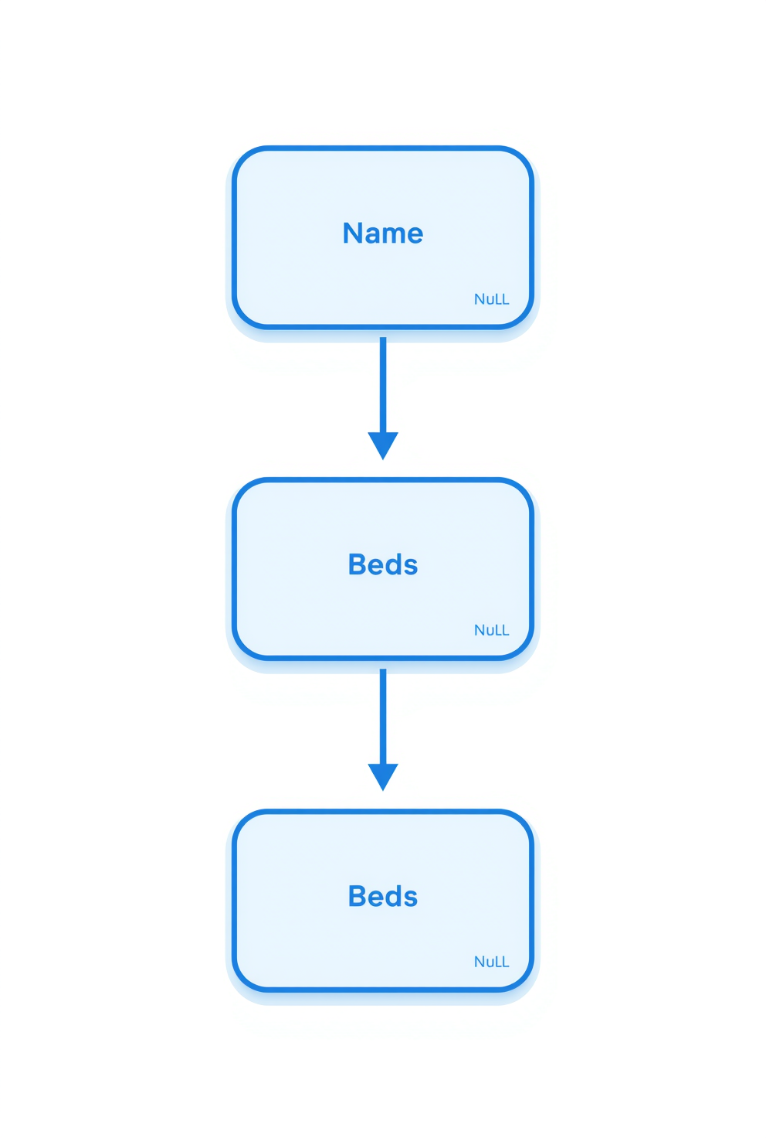
SYSTEM DESIGN & DATA STRUCTURE
The system uses a singly linked list to store hospital records dynamically. Each node in the list contains four key fields: Hospital ID (unique identifier), Hospital Name, Available Beds count, and a pointer to the next node in the sequence.
Dynamic memory allocation using malloc() enables flexible record management, allowing hospitals to be added or removed at runtime. This structure ensures efficient memory usage and supports scalable data handling without predefined size limits.

Slide 6



CRUD OPERATIONS
EXPLAINED
Create: Allocate memory using malloc(), input hospital data (ID, name, beds), insert new node at head of linked list. Read: Traverse the linked list sequentially, display all hospital records with their current data fields.
Update: Search by hospital ID, modify name and bed count fields when found. Delete: Locate target node, track previous pointer, adjust links to bypass node, free allocated memory. Search: Linear traversal comparing IDs, return record or not found.

Slide 7

ALGORITHM WORKFLOW
Add Node: create, input, link to head, update head pointer
Delete Node: search node, track previous, update links, free memory
Search Node: traverse list, compare IDs, return result
Update Node: locate by ID, overwrite details as needed
Each algorithm follows a systematic approach to maintain data integrity. Adding inserts at the head for O(1) efficiency. Deletion carefully manages pointers before freeing memory. Search performs linear traversal until match found. Update combines search with field modification.

Slide 8
TECHNOLOGIES USED
C LANGUAGE & GCC COMPILER
LINKED LISTS
MODULAR DESIGN
Dynamic memory allocation using malloc() and free() for flexible data handling. Pointer manipulation for linked list traversal and node management.
Singly linked list data structure for efficient hospital record storage. Sequential access patterns optimized for CRUD operations.
Modular programming approach with separate functions for each operation. Clean code organization for maintainability and debugging.
This project is built entirely in C without external libraries or databases, demonstrating core programming fundamentals and efficient resource management through clean, modular code architecture.

Slide 9

HOW TO RUN THE PROGRAM
Step 1: Compile using gcc hospital_graph.c -o hospital
Step 2: Execute with ./hospital
Menu interface guides all operations
Menu Options Available:
• Add - Insert new hospital records
• Delete - Remove existing records
• Update - Modify hospital details
• Search - Find hospitals by ID
• Display - View all records
• Exit - Close the program

Slide 10
LIMITATIONS
DATA STRUCTURE CONSTRAINT
BASIC SIMULATION
NO PERSISTENCE
Uses linked list instead of full graph representation, limiting complex hospital network modeling and multi-path transfer scenarios.
No persistent file storage implemented. All hospital data is lost when the program exits, requiring re-entry each session.
Basic patient transfer simulation only. No real-time hospital connectivity or network communication features.
While functional for demonstration purposes, this system has several constraints that limit its real-world applicability. These limitations represent opportunities for future development and enhancement of the hospital resource management system.

Slide 11

FUTURE ENHANCEMENTS
Convert to graph structure (adjacency list)
Implement Dijkstra's algorithm for optimization
Add file handling for persistent storage
Develop GUI with C++ or Python
These planned improvements will transform the current linked list implementation into a full graph-based system, enabling realistic patient transfer simulations with shortest path calculations. File storage ensures data persistence, while a graphical interface and authentication features will enhance usability and security.

Slide 12
THANK
YOU!

